Slide 1
Upcoming changes to NIH biosketch & Other support documents
Updated as of January 12, 2022

Slide 2
Why is NIH changing the biosketch and other support?
The NIH has updated its Biographical Sketch and Other Support documents in order to:
Better provide transparency and disclosure of all research activities
Easily identify undue foreign influence in research
Having a full picture of investigators’ support allows the NIH to make sound funding decisions.
The use of these new formats is in effect now, however NIH has provided a grace period to administer the changes. NIH will enforce the use of the new formats starting on January 25, 2022.
CHOP expects the research community to be fully compliant by October 5th.
Notes:
https://grants.nih.gov/grants/forms/biosketch.htm

Slide 3
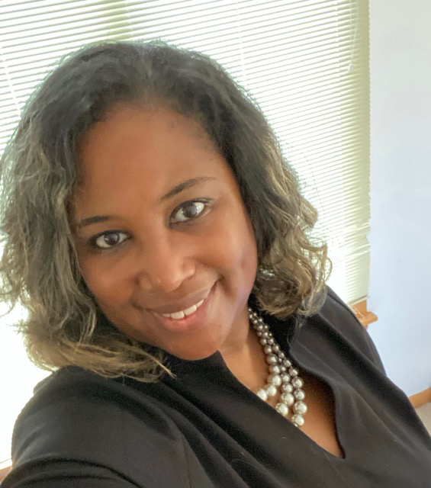
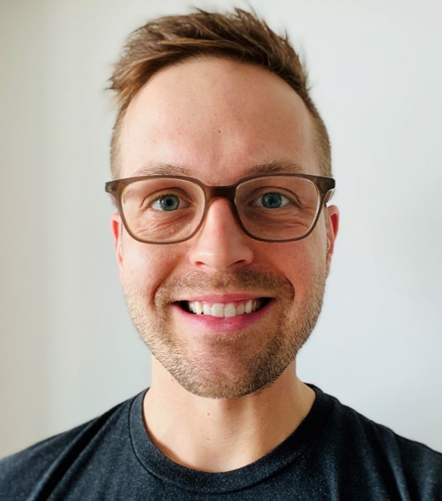
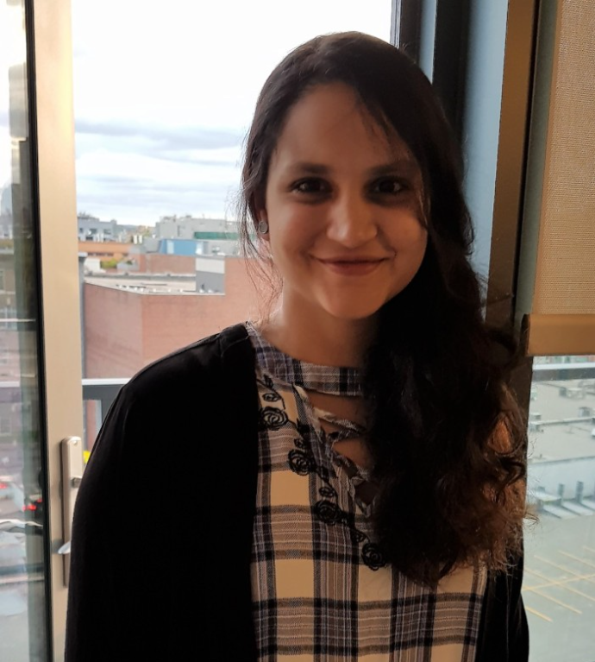
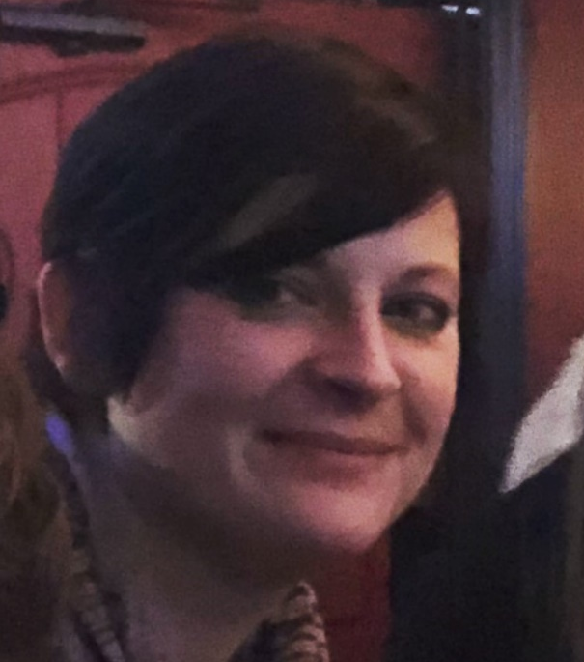
presenters
Patrice Martin, DBA
Sponsored Projects Officer III
Jeff Birou, M.S.Ed
Sponsored Projects Officer II
Amna Raja, MS
Sponsored Projects Officer II
Megan O’Karma, MLIS
Sponsored Projects Officer II

Slide 4
Summary of changes to biosketches non-fellowship applications
Old Format | New Format
Section A: Personal Statement with up to four publications/research products | Section A: Personal statement with up to four publications/research products PLUS option to highlight ongoing and recently completed (past three years) research projects
Section B: “Positions and Honors” List positions you’ve held that are relevant to this application | Section B: “Positions, Scientific Appointments, and Honors” Include all current positions and scientific appointments—both foreign and domestic—in reverse chronological order
Section D: List of Ongoing and Recently Completed Support | Section D: Removed; Support info now to be captured in Section A
Notes:
https://www.colorado.edu/ocg/2021/03/25/nih-important-required-changes-biosketch-and-other-support-forms-and-content

Slide 5
How to complete a biosketch using the new format
The new non-fellowship biosketch format has three sections:
A. Personal Statement
B. Positions, Scientific Appointments, and Honors
C. Contributions to Science
The following fields on Page 1 will not change:
Name
eRA Commons User Name
Position Title
Education/Training

Slide 6
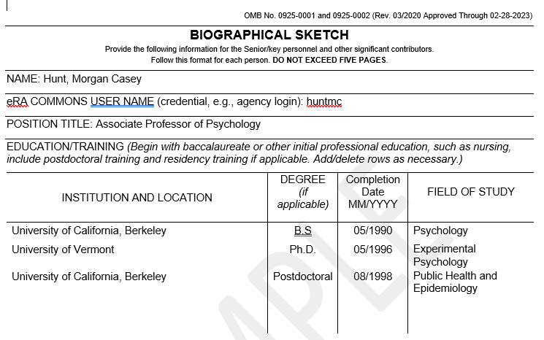
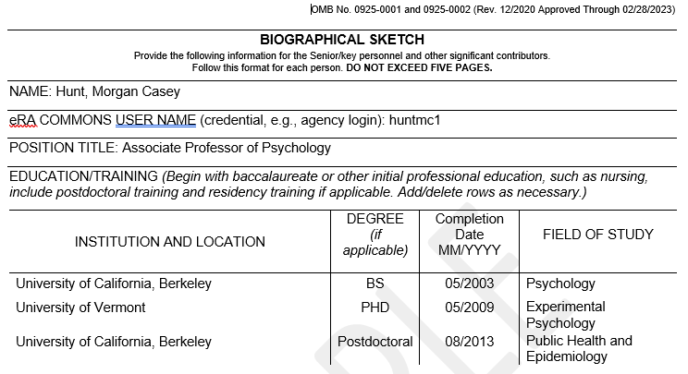
Biographical information
Existing Format
New Format
There is no change to these sections under the updated requirements.

Slide 7
Section a: personal statement
Still requires the personal statement and allows for inclusion of up to four relevant publications or research products.
In addition, you may now include relevant ongoing and completed research projects from the past three years that you want to draw attention to (previously would be included under Section D, Research Support).

Slide 8
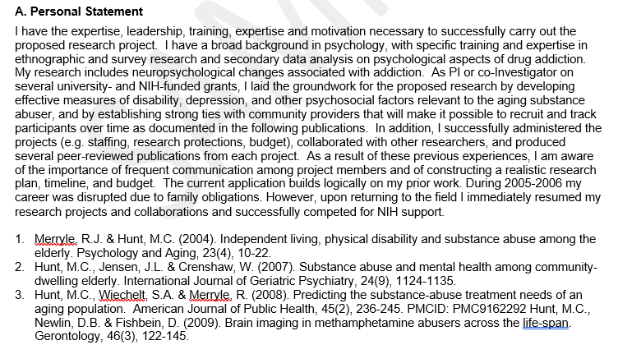
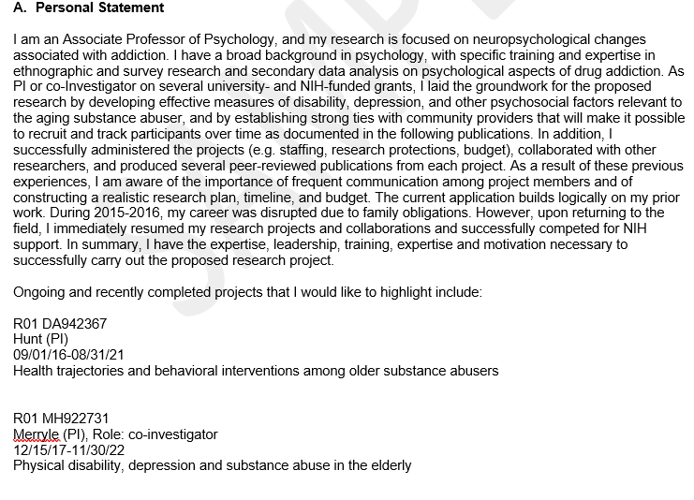
Section a: personal statement
Existing Format
New Format

Slide 9
Section a: personal statement
New Format
Under updated biosketch requirements:
Because Section D. Ongoing and Completed Research Support has been removed, list ongoing and completed research projects from the past three years in this section
You may still cite up to four publications or research products that highlight your experience and qualifications.

Slide 10
Section B: Positions, scientific appointments, and honors
List in reverse chronological order all current positions and scientific appointments, including affiliations with foreign entities or governments. This includes titled academic, professional, or institutional appointments whether or not remuneration is received, and whether full-time, part-time, or voluntary (including adjunct, visiting, or honorary).
Per NIH guidance, the Biosketch must include all active positions and scientific appointments. Positions and appointments that have ended are optional if the applicant wishes to highlight them in support of their application.

Slide 11
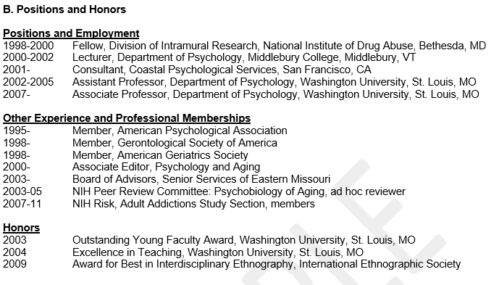
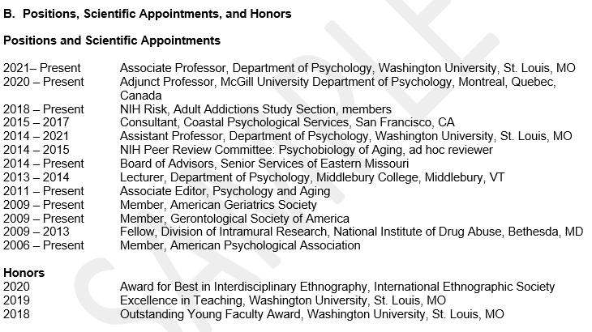
Section B: Positions, scientific appointments, and honors
Existing Format
New Format
In this update, you must now include all positions and scientific appointments, not just a list of positions relevant to your application.

Slide 12
Section B: Positions, scientific appointments, and honors non-fellowship applications
New Format
Section title has been changed to “Positions, Scientific Appointments and Honors”

Slide 13
Section B: Positions, scientific appointments, and honors
New Format
Must include:
All current positions, both domestic and foreign
All current scientific appointments (new requirement), both domestic and foreign
All current affiliations with foreign entities or governments
All current titled academic, professional or institutional appointments, whether or not remuneration is received, and whether full-time, part-time or voluntary (including adjunct, visiting, or honorary).

Slide 14
Section C: contributions to science
This section remains unchanged from the last biosketch format.
“Briefly describe up to five of your most significant contributions to science. For each contribution, you may cite up to four publications or research products that are relevant to the contribution.”

Slide 15
Section D: Research Support
This section has been removed entirely from biosketches for non-fellowship applications.
For Fellowship applications, applicants for dissertation research grants (e.g., R36), and candidates for research supplements to promote diversity in health-related research from the undergraduate through postdoctoral levels, Section D remains but has been renamed “Section D. Scholastic Performance.”

Slide 16
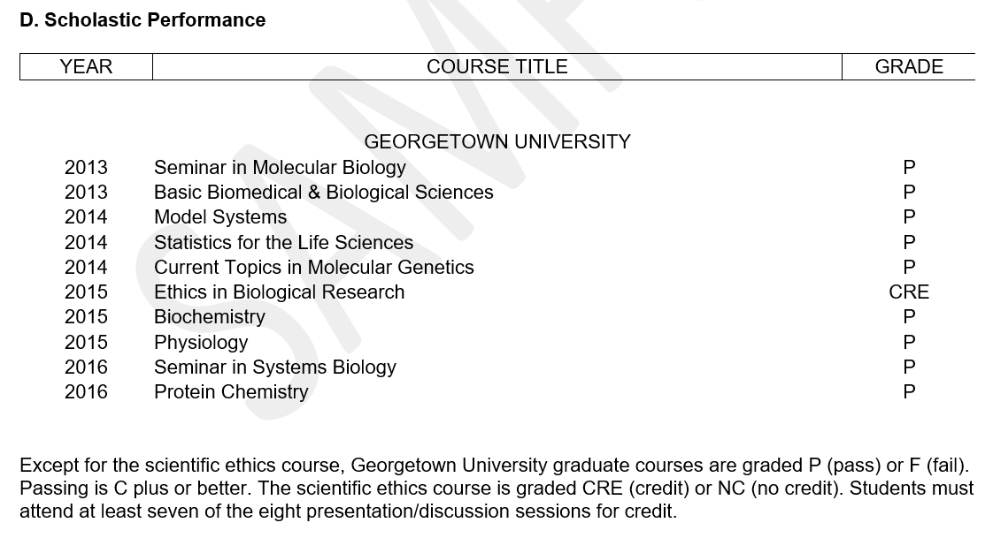
Section D: scholastic performance fellowship applications only
New Format
This section has been updated to remove the Research Support, which will now be captured in Section A.

Slide 17
BIOSKETCHES - STILL ENFORCED non-fellowship applications
Limited to five pages
0.5 inch margins on all sides
Figures, tables and graphics not allowed
Hyperlinks/URLs only allowed (.gov) when specifically noted in funding opportunity announcement and form field instructions
All Senior/Key Personnel and Other Significant Contributors (OSCs) must include Biosketches with NIH applications

Slide 18
SCIENCV: generate your biosketch
Science Experts Network Curriculum Vitae (SciENcv) is a tool investigators can use to build and maintain NIH and NSF-compliant biosketches for proposals and reports.
SciENcv uses information from MyNCBI, ORCID, and eRA Commons so researchers can quickly build a biosketch.
URL: https://www.ncbi.nlm.nih.gov/sciencv/
Log in using your eRA Commons or Research.gov username
Credit: PSU Libraries
Notes:
https://guides.libraries.psu.edu/sciencv
https://researchguides.uic.edu/nihbiosketch/SciENcv

Slide 19
NIH Other Support Definition
“Other support includes all resources made available to a researcher in support of and/or related to all of their research endeavors, regardless of whether or not they have monetary value and regardless of whether they are based at the institution the researcher identifies for the current grant.”

Slide 20
WHY FOREIGN COMPONENT
The NIH has updated its Biographical Sketch and Other Support documents in order to better provide transparency and disclosure of all research activities, and more easily identify undue foreign influence in research. Having a full picture of investigators’ support allows the NIH to make sound funding decisions.
FEDERAL
Collaborations with entities outside of CHOP—whether foreign or domestic—are valuable and encouraged, with the understanding that the integrity of the Institute and its research depends on a high degree of transparency concerning such relationships. Compliance with the new OS requirements is in the interest of maintaining the Research Institute’s distinguished reputation, upholding our organizational values, and contributing to our mission and vision.
CHOP
Evidence of intent to not disclose foreign affiliations, support, and interests, and efforts to conceal nondisclosure, have led to prosecution (e.g., false claims, wire and tax fraud) and dismissal across the US research enterprise. Compliance will minimize follow-up by NIH after Other Support submissions.
INVESTIGATORS

Slide 21
OVERVIEW OF OTHER SUPPORT
WHY
WHAT
WHEN
To provide transparency and disclosure of all research activities, and more easily identify potential foreign influence in research.
Resources and financial support from all foreign and domestic entities
In-kind contributions
Financial support for laboratory personnel
Consulting agreements – US / foreign
Start-up funds provided by outside orgs
Proposal stage → K awards (KP / OSC)
Post Proposal stage → JIT
Post Award yearly →RPPR
Prior Approval → Adding new Key Personnel
HOW
WHO
WHERE
WHO
Active & Pending Support with Overlap statement as before, PLUS:
Separate $ support from In-kind
Include person months’ effort by year
Attach copies of grants, contracts, or agreements with foreign component (translated if not in English)
eSPA as a resource for active / pending grants
eCOI for outside activities & foreign component
eAgreements for CHOP related consulting agreements
SOPHIA for industry agreements
PIs / PIDs gather and draft OS
RBA confirm efforts
SPO complete admin review
PI must sign final OS document prior to submission

Slide 22
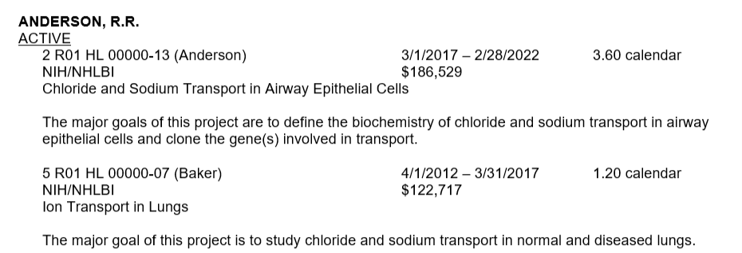
OLD v. NEW
Organized by Active/Pending
Grant Number, Primary Award PI, Project Start/End Dates, Sponsor Agency, Total Awarded Costs, Project Title, Major Goals
Effort for current year
Overlap Statement (scientific, budgetary, and commitment overlap)
Organized by:
Active/Pending
Funded/In-Kind, including any foreign source of support (new)
Grant Number, Primary Award PI, Project Start/End Dates, Sponsor Agency, Total Awarded Costs, Project Title, Major Goals
Effort for all years (new)
Overlap Statement (scientific, budgetary, and commitment overlap)
Primary Place of Performance (new)
Signature block (new)

Slide 23
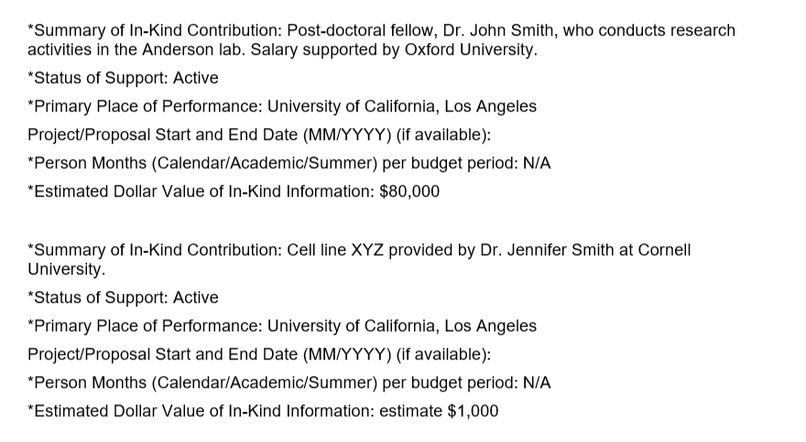
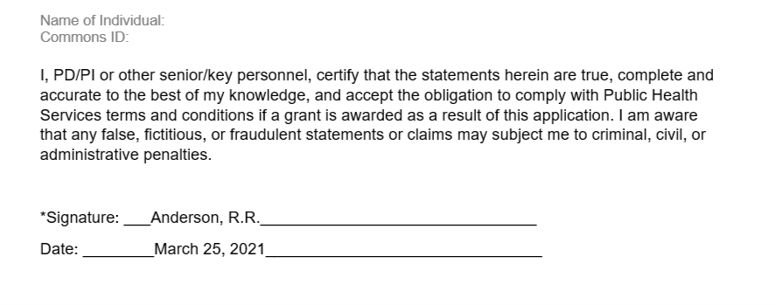
Screenshots from the NIH sample
List of In-Kind Contributions
Signature Block

Slide 24
Samples: REPORTING DOMESTIC CONTRIBUTIONs
Income, salary, and consulting fees in support of an individual's research endeavors:
Institution Name / Type / Amount
University of North Carolina at Greensboro / Consultation / $1,000 per hour for 20 hours
In-kind contributions from domestic institutions that support research activities:
Institution Name / Name of Lab / Describe in-kind contributions / Covering Period
Duke University / Dr. Strange Lab / worked on NIH grant 5R01AIXXXXXX-03 while serving as adjunct professor in summer 2020
Post-doc, student, or visiting scholar supported by a domestic institution:
Institution Name / Individual Name / Type / Calendar Month FTE
Boston University / Bruce Banner, PhD / Post-Doc / 6.00CM

Slide 25
SAMPLEs: REPORTING FOREIGN COMPONENT / IN-KIND CONTRIBUTIONS
Income, salary, and consulting fees in support of an individual's research endeavors:
Institution or Government Name / Type / Amount
Government of China / Consultant / $1,000 per hour
Participation in a foreign talent or similar-type programs:
Institution or Government Name / Title / Name of Program / Dollar Amount
Proteona Pte Ltd, Singapore / Proteona Oncology Challenge Grant Award / USD $50,000
Listing of all foreign resources and other support, for ongoing research projects, including those conducted at a different institution:
Institution or Government Name / Type of foreign resource or other support
Macquarie University, Australia / Board member / Consultation / No fees
In-kind contributions from foreign institutions or governments that support research activities:
Institution or Government Name / Name of Lab / Describe in-kind contributions / Covering Period
German Institute of Research / Gunther Stein Lab / work on university research grant while serving as adjunct professor cover period from July 1, 2019 to June 30, 2020
Post-doc, student, or visiting scholar supported by a foreign government or institution:
Institution or Government Name / Individual Name / Type / Calendar Month FTE
Pepper Potts, PhD / Visiting Scholar / University of Iceland / 6.00CM

Slide 26
WHAT TO INCLUDE / WHAT TO LEAVE OUT
Financial support for laboratory personnel
Core facilities or shared equipment that is made broadly available (belongs in Facilities and Other Resources)
Provision of high-value materials that are not freely available (biologics, chemicals, model systems, technology, etc.)
Training awards, prizes, honoraria or gifts
Consulting agreements where conducting research is part of the agreement
Non-research related consulting activities
In-Kind contributions of office/laboratory space, equipment, supplies, or employees or students supported by an outside source.
Internal CHOP start-up funds (However DO include internal competition such as Foerderer Awards if there is measurable effort)

Slide 27
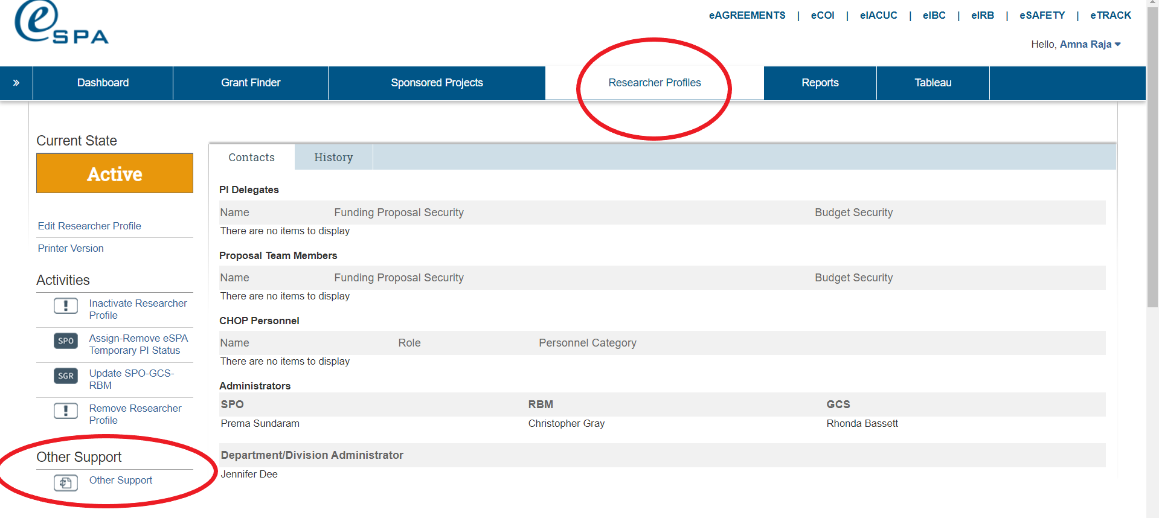
USING eSPA FOR OS

Slide 28
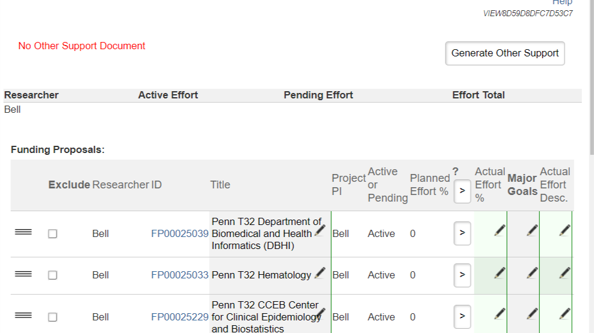

Slide 29
USING eCOI TO COLLECT INFORMATION
WHO
HOW
WHAT
WHERE
All PIs are expected to complete Annual Disclosure Form / Project Specific Disclosure via eCOI database which centralizes and summarizes reports.
You must disclose here even if you have already disclosed elsewhere.
Log into https://resckapp01.research.chop.edu/eCOI
Responses should be as detailed as is reasonable to ensure accuracy.
If in doubt, disclose.
It is better to provide too much information than not enough.
Disclosures should capture all Outside Activities,
Ownership Interests, Intellectual Property,
Non-US Funding & Affiliations
Useful summary to add to your OS!
Select most recent disclosure from eCOI Dashboard.
Sample text: “Your personal disclosure may be found here:
DISC-000xxxxx”
Scroll to Summary tab and
select Printer Version of your project specific disclosure from the left-hand column.

Slide 30
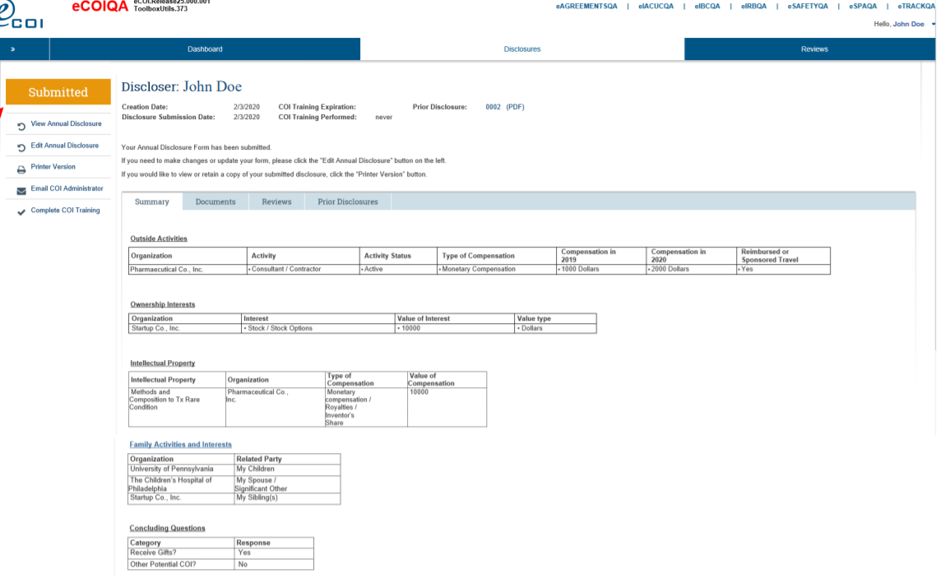
Adding information from ecoi pORTAL

Slide 31
OCCRC / SOPHIA for Industry Research Agreements
MTA
Material Transfer Agreements and Amendments (MTAs)
CTA
Industry funded Human Subjects Research
Industry-funded Clinical Trial Agreements (CTAs) & Amendments Subcontracts flowing down from CTAs
DDB
Drug/Device/Biologic Agreement (DDB)
DUA
Data Use Agreements (DUAs) and Data Transfer Agreements → Specific to Research or Data Generated by Research Funding
Visiting Scientists
Visiting Scientist Agreements
Always err on side of disclosure. Reach out to OCCRC Team to request missing copy of an agreement if SPO confirms required in OS.
OCCRC Dept. Assignment : https://www.research.chop.edu/sites/default/files/OCCRC_Departmental_Assignments.pdf
OCCRC Contacts: bartunekc@chop.edu (Charles Bartunek, OCCRC Director); researchcontracts@chop.edu (general mailbox)

Slide 32
Key takeaways – IT’s all about you!
Start drafting / compiling early
CHOP expects PIs to use the new format by October 2021
Leverage the resources available like eSPA for OS template / eCOI / eAgreements / SOPHIA for additional information ( SCIENCV will have an OS starting 2022)
Your OS/ Biosketch is a living document that you should frequently update
Contact your SPO any time you have questions
(the earlier the better!)
Err on the side of disclosing more than less
Work with RBA to verify effort in OS
Final sign off / ownership belongs to the PI
Maintain a Working Draft
Add & Refine Information
Review & Sign Off

Slide 33
Updated Biosketch and OS Guidance from Other Federal Agencies
National Science Foundation
Department of Defense – Consult General Instructions Per RFA
Department of Energy – FOA specific
National Aeronautics and Space Administration

Slide 34
QUESTIONS?

Slide 35
Thank you for attending
If you have questions after the session, please contact your SPO.
RESOURCES Upcoming Changes to the Biographical Sketch and Other Support Format Page (NOT-OD-21-073) https://grants.nih.gov/grants/guide/notice-files/NOT-OD-21-073.html NIH Biosketch Format Pages, Instructions and Samples https://grants.nih.gov/grants/forms/biosketch.htm NIH Other Support Format Pages, Instructions and Samples https://grants.nih.gov/grants/forms/othersupport.htm NIH Other Support and Foreign Component FAQ https://grants.nih.gov/faqs#/other-support-and-foreign-components.htm?anchor=alphaHeader4226 How to find your SPO/RBA/GCS https://sprbm.research.chop.edu/
National Science Foundation (NSF) SciENcv Other Support Creation Tool
https://www.ncbi.nlm.nih.gov/books/NBK154494/#sciencv.Using_the_NSF_Current__Pending_S

